Slide 1
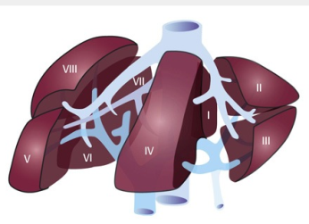
PERIOPERATIVE MANAGEMENT OF THE PATIENTS WITH LIVER DISEASE
.
Dr - MOHAMMED EMAM
PROF. GASTRENTROLOGY &HEPATOLOGY
ZAGAZIG UNIVESITY -EGYPT

Slide 3
INTRODUCTION
Due to the loss of hepatic reserve capacity and because of other systemic derangements that are the result of liver dysfunction (such as hemodynamic impairments), patients with liver disease have an inappropriate response to surgical stress.

Slide 4
INTRODUCTION
Hepatic patients are at an increased risk of bleeding, infection, postoperative hepatic decompensation, (hepatic coma or death).

Slide 5
INTRODUCTION
Therefore, the decision to perform surgery in these patients must be heavily weighed.

Slide 6
Overview
*The number of patients with cirrhosis who require surgery is on the rise.

Slide 7
Overview
The amount of medications aimed at improving survival among patients with cirrhosis has been increasing. Therefore, it can be expected that a growing number of patients with liver disease, both known and as yet undiagnosed and asymptomatic, will undergo surgery.

Slide 8
Incidence
An estimated 1 in 700 patients admitted for elective surgery has abnormal liver enzyme levels(in USA).
Some authors have estimated that as many as 10% of patients with advanced liver disease will undergo surgery in the last 2 years of their lives

Slide 9
Importance
*Identification of the surgical risk is critical in the care of any patient, especially as patients develop an increasing number of chronic co-morbid medical conditions.
** Patients with liver disease are at particularly high risk for morbidity and mortality in the postoperative period due to both the stress of surgery and the effects of general anesthesia

Slide 10
Importance
Patients undergoing non hepatic general surgery has mortality rates about 16.3% for patients with cirrhosis compared with 3.5% in the control group during first month .

Slide 11
De compensated liver disease increases the risk of postoperative complications (e.g., acute hepatic failure, infections including sepsis, bleeding, poor wound healing, and renal dysfunction).
Assessing risk in these patients is a not easy but important effort.

Slide 12
In general, the liver has large functional reserve because of its dual blood supply: portal-venous (75%) and hepatic-arterial (25%). Hence, clinical manifestations of liver damage occur only after considerable injury

Slide 13
SURGICAL RISK ASSESSMENT

Slide 14
Prediction of surgical risk
The extent of liver dysfunction and type of surgery play key roles in determining a patient’s specific risk.
.

Slide 15
Prediction of surgical risk
In addition, liver disease can affect almost every organ and system in the body, including the respiratory and circulatory systems, the brain, the kidneys, and the immune system.

Slide 16
The extent to which secondary manifestations of liver disease affect other systems may be just as important as the manifestations of primary liver dysfunction in predicting the outcome after surgery

Slide 17
Co morbid conditions responsible for peri- operative morbidity and mortality (eg, coagulopathy, intravascular volume, renal function, electrolytes, cardiovascular status, and nutritional status) should be identified before surgery

Slide 18
Optimal preparation may decrease death and complications after surgery.

Slide 19
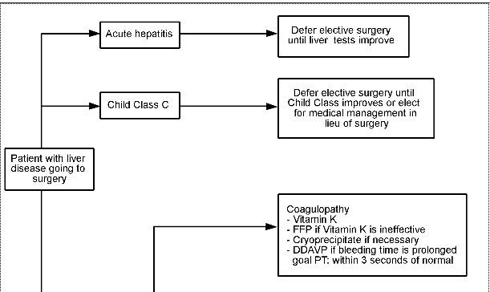
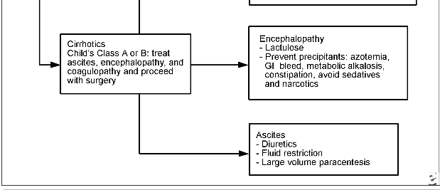
Algorithm for a patient with liver disease for whom surgery is being consider

Slide 20
Quantitative risk stratification
Two risk stratifications schemes have been used to estimate the perioperative risk of patients with cirrhosis: the Child-Turcotte-Pugh score and the Model for End-Stage Liver Disease (MELD) score.

Slide 21
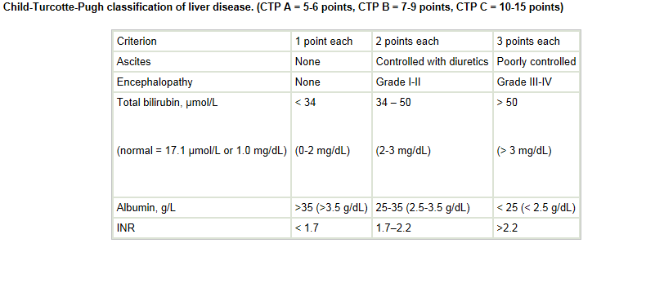

Slide 22
The CTP score
Patients with CTP class A disease are estimated to have a 10% mortality rate after abdominal surgery. That mortality rate increases to 30-31% for CTP class B and 76-82% for CTP class C

Slide 23
CTP SCORE
However, the CTP scoring system has been challenged for its doubt and interobserver variability because it includes subjective parameters (eg, degree of ascites and encephalopathy
. Patients within a given class are not homogenous but also not distinguished between, a feature for which it has also been criticized

Slide 24
The MELD score
calculated from equation, :
(3.8 ×log bilirubin value) + (11.2 Xlog INR) + (9.6 Xlog creatinine value),
where bilirubin and creatinine values are in milligrams per deciliter (mg/dL)

Slide 25
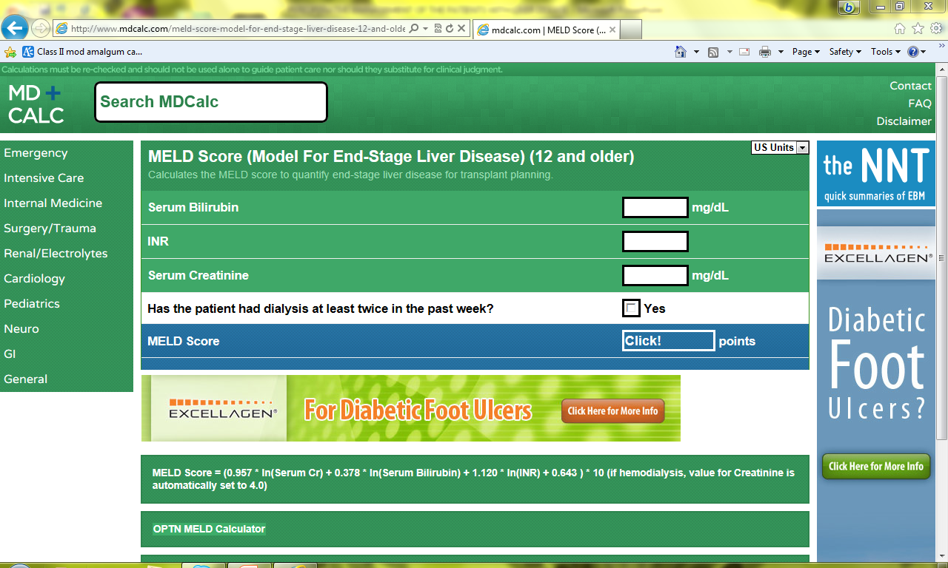
The MELD score

Slide 26
A MELD score of at least 8 predicts an increased risk of postoperative complications, including death in patients undergoing surgery.

Slide 27
the MELD score predicts morbidity and mortality after hepatic resection for hepatocellular carcinoma.
MELD scores < 9 were associated with 0% postoperative liver failure; MELD scores 9-10 were associated with 3.6% postoperative liver failure; and MELD scores >10 were associated with 37.5% postoperative liver failure

Slide 28
In general, the MELD score fairs well compared to the CTP score. However, some might disagree that the MELD score may be a more objective predictor of postoperative mortality than the CTP score

Slide 29
multivariate analysis that showed among patients with cirrhosis undergoing multiple types of major surgeries, the MELD but not the CTP score predicted increased mortality at 30 and 90 days, 1 year, and over the long term

Slide 30
Integrated MELD
More recently, the MELD score has been adapted with additional clinical risk factors, creating the "integrated MELD" score (iMELD): iMELD = MELD + (0.3 X age) - (0.7 X serum sodium [mEq/L]) + 100

Slide 31
In a retrospective study of 190 patients with cirrhosis, demonstrated that the iMELD score had better prognostic strength compared with the MELD or CTP scores.,
I MELD scores of < 35, 35-45, and >45 were associated with perioperative mortality rates of 4%, 16%, and 50%, respectively.

Slide 32
The ASA risk stratification systems
Based on comorbid conditions that are a threat to life or that limit activity and thus helps in predicting preoperative risks. In general, an ASA class greater than 2 increases the risk 1.5- to 3.2-fold.

Slide 33
The ASA risk stratification systems
with ASA class V the strongest predictor of postoperative mortality at 7 days.
The mortality related to ASA IV was the equivalent of 5.5 MELD points in terms of risk.

Slide 34
Metabolic equivalent [MET]
It is also important to not overlook the preoperative cardiopulmonary evaluation.
Cardiac risk stratification should include an assessment of functional capacity (metabolic equivalent [MET] or exercise duration).

Slide 35
Metabolic equivalent [MET]
Additional noninvasive testing such as stress testing might be considered if it will change peri-operative manag.
Cardiac surgery performed in patients with cirrhosis is associated with a high surgical mortality rate

Slide 36
Preoperative Assessment and Management

Slide 37
Asymptomatic patients
The evaluation of any patient undergoing surgery should include
1_ thorough history taking and physical examination. , Risk factors (eg, pervious blood transfusions, tattoos, illicit drug use, sexual history, alcohol use, and personal or family history of jaundice) for liver disease should be explored

Slide 38
2_A complete medication review including other-the-counter (OTC) and herbal agents.
3_Symptoms or physical signs suggestive of liver dysfunction/disease (eg, hepatosplenomegaly, spider angioma, jaundice, gynecomastia, palmar erythema, scleral icterus, asterixis, encephalopathy)

Slide 39
4_liver function tests, coagulation studies, complete blood cell (CBC) counts and metabolic panels.
However, routine preoperative testing of liver function is not recommended because of the low prevalence of liver abnormalities in clinically asymptomatic patients

Slide 40
Asymptomatic patients with significantly abnormal liver function
should have their elective surgery postponed and their liver disease investigated; their perioperative risk should be reassessed after their liver dysfunction is characterized

Slide 41
Acuity of liver disease
patients with acute hepatitis have been associated with an increased risk of surgical morbidity and mortality . This also applies to patients with acute alcoholic hepatitis. Patients with these conditions tend to have morbidity rates higher than those with chronic cholestatic disease.

Slide 42
Acuity of liver disease
Therefore, it is prudent to postpone surgery, especially elective surgery, until transaminitis is resolved.
Patients with chronic liver disease but with preserved hepatic function may not have an increased operative risk, but these individuals need to be closely evaluated nonetheless

Slide 43
Severity and specific derangements of known chronic liver disease
In patients with known liver disease, especially with cirrhosis, optimal preparation for surgery may decrease the risk of complications or death after surgery. This includes laboratory tests to assess blood counts, coagulopathy, electrolyte abnormalities, and markers of hepatic synthetic function

Slide 44
Coagulopathy and thrombocytopenia
. Hepatic synthetic dysfunction (all of the coagulation factors with the exception of von Willebrand factor are produced in the liver),
. Malnutrition and vitamin K malabsorption due to cholestasis contribute to this abnormality.
. Additionally, portal hypertension leads to hypersplenism with resultant platelet. trapping and peripheral thrombocytopenia

Slide 45
*Vitamin K supplementation and fresh-frozen plasma (FFP) are recommended to correct coagulopathy before surgery.
*Cryoprecipitate might also be required to reduce the prothrombin time.
* A prolonged bleeding time can also be corrected
with diamino-8-D-arginine vasopressin (DDAVP) (Desmopressin (trade names:, Minirin).
* Finally, platelet transfusion may be necessary based on the patient’s platelet level and the desired level as dictated by the type of surgery

Slide 46
Cryoprecipitate
is prepared from plasma and contains fibrinogen, von Willebrand factor, factor VIII, factor XIII and fibronectin. Cryoprecipitate is the only adequate fibrinogen concentrate available for intravenous use.
Cryoprecipitate is available in pre-pooled concentrates of six units. Each unit from a separate donor is suspended in 15 mL plasma prior to pooling. For use in small children, up to 4 single units can be ordered. Each unit provides about 350 mg of fibrinogen

Slide 47
Ascites
*Ascites is important to assess and manage before surgery because it can lead to wound dehiscence, abdominal wall herniation, and respiratory compromise secondary to reduced lung expansion
* Ascites in patients with cirrhosis was associated with a 37-83% mortality rate compared with 11% in those without ascites.

Slide 48
Ascites
*In general, ascites should be treated aggressively with diuretics and/or large-volume paracentesis before surgery.
*A low sodium diet is important component of ascites management. *Patients on diuretics need to have their creatinine and electrolytes monitored.

Slide 49
Ascites can be removed intraoperatively at
laparotomy.
It is important to note of the volume of fluid removed and the patient’s baseline renal function and to consider albumin replacement to maintain intravascular volume and prevent paracentesis-induced circulatory dysfunction.
Ascitic fluid should also be analyzed to rule out spontaneous bacterial peritonitis.

Slide 50
Encephalopathy
Patients with encephalopathy at baseline, have increased their risk of postoperative encephalopathy.
Non hepatic surgery demonstrated that encephalopathy was associated with an 88% risk of mortality, which was even higher than the 50% risk associated with emergency surgery

Slide 51
Multiple factors in the preoperative and postoperative periods may precipitate encephalopathy, such as infection and/or sepsis, diuretics, hypokalemia, metabolic alkalosis, constipation, use of central nervous system (CNS) depressants such narcotics and benzodiazepines, hypoxia, azotemia, and gastrointestinal bleeding..

Slide 52
. Addressing the underlying precipitant :through
1_ Correction of electrolyte abnormalities, 2_Treatment of infection,
3_ management of gastrointestinal bleeding,
4_ restriction of sedatives may help prevent or decrease encephalopathy.

Slide 53
Renal dysfunction
*Patients with chronic liver disease are at risk for renal dysfunction at baseline due to the tendency for hemodynamic derangements that increase the risk of renal hypoperfusion.
*This risk is increased by diuretics, nephrotoxic agents including nonsteroidal anti-inflammatory drugs (NSAIDs), large-volume paracentesis performed without albumin supplementation, infections, and gastrointestinal bleeding.
* Hepatorenal syndrome is another concerning occurrence in this patient population.

Slide 54
*The risk of renal dysfunction in the postoperative period is increased due to hemodynamic changes and fluid shifts or losses, particularly if ascites fluid is removed at laparotomy.
* Renal function should be closely monitored pre- and postoperatively, with appropriate measures taken to address or eliminate potential insults

Slide 55
The risk of renal dysfunction in the postoperative period
. *serum creatinine levels often overestimate the glomerular filtration rate (GFR) in patients with cirrhosis; a seemingly normal creatinine level may indeed represent impaired renal function.
* Vasoactive compounds such as midodrine and terlipressin appear to be at least as effective as intravenous albumin in preventing circulatory dysfunction with resultant renal impairment in patients with cirrhosis who have lost third-spaced volume

Slide 56
Pulmonary disease
Pulmonary complications of end-stage liver disease include hepatopulmonary syndrome, portopulmonary hypertension, and hepatic hydrothorax.
Hepatopulmonary syndrome is associated with vascular shunt, and the risk of hypoxia and ventilation-perfusion mismatch should be addressed before surgery

Slide 57
.
The associated hypoxemia is usually not severe.
Drainage is usually not recommended because the effusion often rapidly reaccumulates.
Finally, the risk of chronic obstructive pulmonary disease (COPD) should be assessed in any patient who has previously smoked tobacco or who has alpha-1 antitrypsin deficiency.

Slide 58
Malnutrition
*-Severe malnutrition is associated with an increased need for packed red blood cells, FFP, and cryoprecipitate during liver transplantation.
*- It is also associated with a prolonged postoperative stay.
*_ preoperative improvement in the patient's nutritional status may improve outcomes

Slide 59
*-Steps to improve nutritional health should be started, preferably in the preoperative period, because they are expected to have increased energy expenditure after surgery.
*_ Supplements can be used.
*_Patients with alcoholic liver disease and Wernicke encephalopathy benefit from preoperative vitamin B-1 supplementation. *_Advanced liver disease can also predispose to hypoglycemia because of impaired gluconeogenesis and decreased glycogen stores.

Slide 60
Disease-specific considerations
*Patients with autoimmune hepatitis on daily steroids may be appropriate candidates for stress-dosed steroids with surgery.
*D-penicillamine can impair wound healing;
*patients taking it for Wilson disease should decrease their dose for 1-2 weeks pre- and postoperatively.
* Wilson disease might predispose to an increased risk of neurologic changes postoperatively.

Slide 61
Disease-specific considerations
. Patients with a history of alcohol abuse are at increased risk of other complications, including poor wound healing, bleeding, delirium, and infections.
Patients who have continued to actively drink are at risk for withdrawal

Slide 62
INTRA OPERATIVE FACTORS

Slide 63
Anesthesia
* Decreased synthesis of plasma-binding proteins. Hypo albuminemia impairs drug binding and metabolism and elevates serum drug levels in C L D.
* Impaired drug metabolism, detoxification, and excretion by the liver can prolong drug half-lives. Thus, the absorption, distribution, metabolism, and excretion of anesthetics, muscle relaxants, analgesics, and sedatives may be affected.

Slide 64
**Patients with liver disease are more likely than patients without liver disease to have hepatic decompensation with the use of anesthesia .
*General anesthesia reduces total hepatic blood flow, especially the contribution of the hepatic artery.
*Patients with liver disease tend to have several baseline cardiovascular abnormalities, including decreased systemic vascular resistance and increased cardiac index, which may further affect hepatic blood flow.

Slide 65
.* In addition, catecholamine and other neuro -hormonal responses are impaired in patients with liver disease; therefore, intraoperative hypovolemia or hemorrhage may not trigger adequate compensatory mechanisms.
* Anesthetics causing sympathetic blockade further blunt this response. The result of this reduction in hepatic perfusion is a drastic loss of their remaining marginal hepatic function.

Slide 66
Halothane and enflurane appear to reduce hepatic artery blood flow because of systemic vasodilation and a mild negative inotropic effect.
Halothane is also associated with greatest risk of hepatotoxicity.
The incidence of fulminant hepatitis approximating 1 case in 6,000 of healthy patients after exposure.

Slide 67
Isoflurane has fewer effects on hepatic blood flow and less hepatic metabolism ; it is the preferred anesthetic agent in patients with liver disease.
Newer haloalkanes, such as sevoflurane and desflurane, also undergo less hepatic metabolism than halothane or enflurane

Slide 68
The drug effects of neuromuscular blocking agents may be prolonged in patients with liver disease because of impaired biliary excretion.
Atracurium has been recommended as the agent of choice because it relies on neither the liver nor kidney for excretion..[

Slide 69
Drugs such as morphine, meperidine, benzodiazepines, and barbiturates should be used with caution because of their dependence on the liver for metabolism.
The doses of these agents should be decreased by 50%.
Fentanyl is the preferred narcotic.

Slide 70
Surgery
The type of surgery is potentially an important determinant of postoperative hepatic dysfunction.
Because of traction on abdominal viscera, intra-abdominal operations are more likely than extra-abdominal surgeries to cause reflex systemic hypotension and to subsequently reduce hepatic blood flow.

Slide 71
Surgery
. Hypercarbia-induced splanchnic vasoconstriction is also a threat to hepatic perfusion.
Surgeries that result in a large amount of blood loss increase the risk for ischemic hepatic injury, as can intraoperative
hypotension
. Sufficient surgical hemostasis and platelet-rich plasma have been demonstrated to be useful for prevention of massive hemorrhage.

Slide 72
Examples of specific surgeries and considerations
Cholecystitis and cholelithiasis are common in
patients with liver disease.
The perioperative mortality in patients with liver disease who undergo cholecystectomy is 8.47.
* open cholecystectomy in patients with cirrhosis has been called a formidable operation.
* MELD score greater to or equal to 8 predicts an increased risk of postoperative complications in this type of surgery
*laparoscopic cholecystectomy can be safely performed in selected patients who have well-compensated cirrhosis and no signs of portal hypertension

Slide 73
Cardiac surgery in patients with cirrhosis is associated with a high operative mortality rate
The following risk factors for operative mortality: obstructive jaundice, hematocrit value < 30%, serum bilirubin level >11 mg/dL, malignant biliary obstruction, azotemia, and cholangitis,

Slide 74
orthopedic procedures also affect perioperative risk for patients and cirrhosis
Significantly worse outcomes were seen in patients with cirrhosis (20.7% vs 3.23%).
Higher complication rates were seen in cirrhotic patients undergoing emergent total hip arthroplasties for hip fracture repair (80% had a major complication, with 60% mortality rate

Slide 75
Emergency surgery
Patients undergoing emergency surgery are at substantial risk for liver dysfunction. Feeling suggests, the more urgent the surgery, the less opportunity that is available to correct reversible factors, such as electrolyte abnormalities, coagulopathy, and clinical manifestations of portal hypertension (eg, ascites, hepatic encephalopathy

Slide 76
Emergency surgery is an important predictor of adverse outcome.
In a series of 100 patients with cirrhosis who underwent abdominal surgery for a variety of reasons, 80% of non survivors and 40% of survivors who had serious complications had undergone emergency surgery

Slide 77
A series of 92 patients with cirrhosis who underwent abdominal surgeries had a 50% mortality rate in association with emergency procedures (22% for CTP class A, 38% for CTP class B, 100% for CTP class C) versus 18% for elective surgery

Slide 78
patients with cirrhosis had a higher perioperative morbidity and mortality rate with emergency surgery than with elective surgery. Finally, a more recent study found that 100% of patients with cirrhosis undergoing emergency died, with a median survival 2 days^{[16]} ; all these patients had higher MELD scores and were ASA cla

Slide 79
Alternatives to surgery
Relatively noninvasive techniques or advances in medical management have replaced surgical intervention for many conditions (eg, extrahepatic biliary obstruction, refractory variceal hemorrhage, coronary artery disease).
* TIPS has become the treatment of choice for managing cases of refractory variceal bleeding, and surgical shunts are created only in special circumstances.

Slide 80
Alternatives to surgery
ERCP is now commonly used for biliary strictures and choledocholithiasis.
Coronary angioplasty and percutaneous *coronary interventions have decreased the need for coronary artery bypass grafting (CABG).
*The use of proton-pump inhibitors (PPIs) along with antibiotic treatment of Helicobacter pylori has usurped the need for surgical treatment of peptic ulcer disease (PUD) with antrectomy and/or vago

Slide 81
Post operative monitoring

Slide 82
In patients with cirrhosis, liver failure is the most common cause of postoperative death.
Hepatocellular injury is most commonly due to the effects of anesthesia, intraoperative hypotension, sepsis, or viral hepatitis.
A low threshold is generally maintained for postoperative transfer to the intensive care unit (ICU

Slide 83
Patients must be observed closely for signs of acute hepatic decompensation, such as worsening jaundice, encephalopathy, and ascites.
Sedatives and pain medications should be carefully titrated to prevent an exacerbation of hepatic encephalopathy; the increased half-life of hepatically metabolized drugs will make patients with liver disease more sensitive to standard doses

Slide 84
Renal function should also be monitored because of the risk of hepatorenal syndrome and fluid shifts that occur due to surgery.
Monitoring for surgical site complications such as infections, bleeding, and dehiscence.
Additionally, it is now recognized that an elevated international normalized ratio (INR) in the setting of chronic liver disease does not appear to protect patients from hospital-acquired deep venous thromboses or pulmonary emboli

Slide 85
Serious sequelae of decompensated cirrhosis include severe sepsis and secondary disseminated intravascular coagulation (DIC).
These potential complications emphasize the need for maintaining a low threshold for ICU-level monitoring.

Slide 86
Conclusion
1-Surgery in a patient with liver disease, especially end-stage liver disease with cirrhosis and portal hypertension, poses a formidable challenge for all physicians involved.
2- Targeted interventions before surgery may help to prevent complications and improve outcomes.
3-The cornerstones of perioperative management are medical treatment of the complications of liver disease, including coagulopathy, ascites, encephalopathy, and malnutrition.

Slide 87
4-Attention must also be paid to risk factors for infection and renal dysfunction after surgery.
5- Sepsis, coagulopathy, and emergency surgery are most strongly correlated with postoperative mortality.
6-Evolving knowledge of the effects of anesthesia, improving surgical techniques, and use of improved diagnostic tests will help reduce perioperative complications

Slide 88
7-Established risk stratification systems such as the CTP score, the MELD score, and the ASA physical status class should also be used when evaluating a patient with liver disease for potential surgery.
8-multidisciplinary approach to postoperative care is imperative and should include input from anesthesiologists, surgeons, internists, and hepatologists

Slide 89
General considerations
1-Surgery is contraindicated in patients with CTP class C, high MELD score, ASA class V, acute hepatitis, severe coagulopathy, or severe extrahepatic manifestations of liver disease (eg, acute renal failure, hypoxia, cardiomyopathy).

Slide 90
General considerations
2-Avoid surgery if possible in patients with a MELD score of greater than or equal to 8 or CTP class B unless they have undergone a thorough preoperative evaluation and preparation.
3-Use caution with sedatives and neuromuscular blocking agents

Slide 91
4-Optimize medical therapy for patients with cirrhosis. Correct coagulopathy with vitamin K and FFP to achieve prothrombin time within 3 seconds of normal
5-The goal platelet count is >50-100 × 10³/L but may vary depending on the specific surgery.
6-Minimize ascites to decrease risk of abdominal-wall herniation, wound dehiscence, and problems with ventilation.
7-Address nutritional status.

Slide 92
5-Perform close postoperative monitoring
6-Admission to the ICU may be appropriate after prolonged surgeries, intraoperative hypotension, excessive blood loss, or cardiac and/or pulmonary surgery.
7-Monitor for signs of acute liver failure, including worsening jaundice, ascitesand encephalopathy,.
8-Monitor renal function.
9-Monitor and correct electrolyte abnormalities, especially hypokalemia and metabolic alkalosis.

Slide 94
Data Sources: MEDLINE, EMBASE, Cochrane Register
of Controlled Trials, and citation review of relevant
primary and review articles

