Slide 1
HCV TREATMENT; THE PROMISING FUTURE Dr MOHAMMED EMAM PROF. GASTROENTROLOGY AND HEPATOLOGY ZAGAZIG UNIVERSITY

Slide 3
CLINCAL COURSE IN HCV
Dr MOHAMMED EMAM
PROF. GASTROENTROLOGY AND HEPATOLOGY
ZAGAZIG UNIVERSITY

Slide 4
SESSION 4
DR -MOHAMMED EMAM
PROF.GASTROENTROLOGY AND HEPATOLOGY
ZAGAZIC UNIVERSITY -EGYPT

Slide 5
The future of hepatitis C treatment appears promising.

Slide 6
In next to no time the number of patients who can be treated successfully will likely soon exceed the number of patients who fail to respond to therapy

Slide 7
Where Are We Going? Future Therapies for HCV Infection
A number of therapeutic strategies are currently undergoing investigation, including :

Slide 8
1-Novel forms of interferon* developed to optimize pharmacokinetics and promote adherence to interferon-based regimens..
2-Therapeutic vaccines.
3-Ribavirin analogs.

Slide 9
.
4-Other compounds that interfere with the HCV life cycle are currently undergoing investigation as well.
(DAAS)

Slide 10
Considerable effort has also been extended toward synthesis of agents that act via modulation of the immune system as well as new IFN and RBV preparations

Slide 11
The role of these novel therapeutic strategies in the treatment of HCV infection will be determined on the basis of their efficacy, side-effect profile, and resistance profile.

Slide 12
New IFN preparations
Designed to achieve 3 goals:
(1) to increase the drug's half-life, thereby extending the dosing interval (eg, albinterferon,* controlled-release IFN-α*);
(2) Decrease adverse effects (eg, IFN-λ*);
(3) Facilitate drug delivery through strategies such as oral administration or through devices that provide continuous IFN release.*

Slide 13
NOVEL THERAPIES FOR NON RESPNDERS
-Presently, no USA FDA treatment options exist for patients who do not respond to PEG-IFN/RBV.
- Most efforts in the development of novel anti-HCV treatments have been in the area of direct-acting antiviral agents (DAAs).
-

Slide 14
Where Are We Going? Future Therapies for HCV Infection
The DAAs temporally represent the class most likely to have an impact on the future of disease management, with the protease inhibitors telaprevir* and boceprevir,* which are furthest along in clinical trials, be the first DAAs to become available

Slide 16
ALBINTERFERON Α-2B,*
New treatment options for chronic hepatitis C that offer improved efficacy, tolerability, and convenience compared with weekly interferon alfa (IFNα)-based regimens are needed.
Read More: http://informahealthcare.com/doi/abs/10.1185/03007990902779186

Slide 17
ALBINTERFERON ALFA-2B
Albinterferon alfa-2b has been developed for the treatment of CHC. This agent exhibits a prolonged half-life and duration of antiviral activity that indicate potential suitability for dosing intervals of 2–4 weeks

Slide 18
ALBINTERFERON Α-2B,*
-The human IFN-α-2b protein is fused to human albumin in order to extend the half-life, thereby permitting biweekly dosing.
-900 -1500 μg of albinterferon administered once every 2 weeks can achieve SVR rates similar to those observed with PEG-IFN;

Slide 19
Albinterferon α-2b,*
SVR rates were 48.2% in patients infected with HCV genotype 1 and 79.8% in those infected with genotypes 2 or 3
Adverse events associated with albinterferon were comparable to those observed with

Slide 20
Peg-IFN lambda
Receptors for Alfa Interferons are widely distributed on many cell types, possibly contributing to adverse effects.
Receptors for interferon lambda are expressed on hepatocytes, but expression is lower on hematologic cells and non hepatocyte liver cells

Slide 21
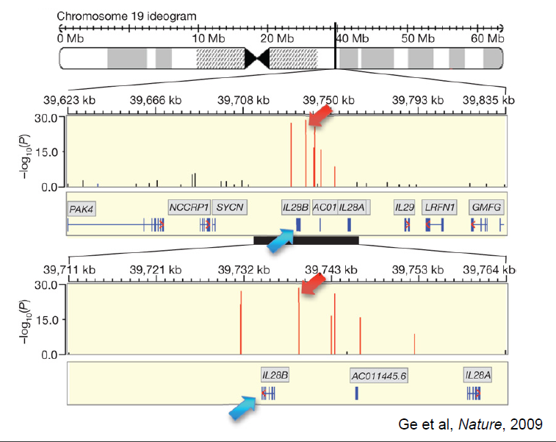

Slide 22
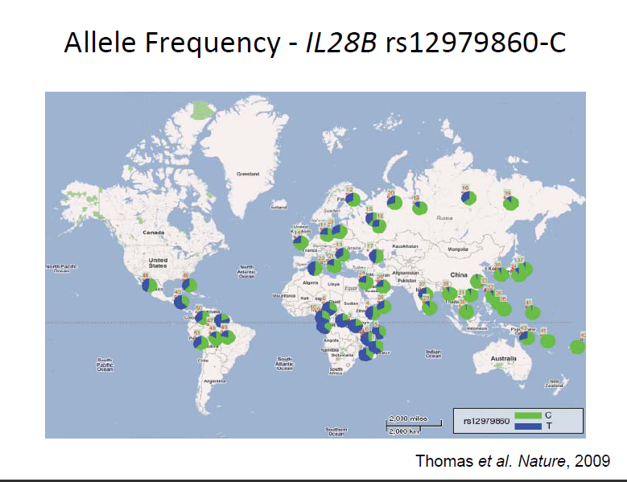

Slide 23
Interferon-λ;Cytokine family discovered via computational prediction from genomic sequence IL29(interferon-λ1)
IL28A(interferon-λ2)
IL28B(interferon-λ3)

Slide 24
Peg-IFN lambda
current therapies with Peg-IFN ALFA are limited by, frequent adverse events, and suboptimal efficacy.
Peg-IFN lambda might be a useful alternative for some patients.
It shares functional similarities with the alfa interferons .
uses the same intracellular signal transduction pathways.

Slide 25
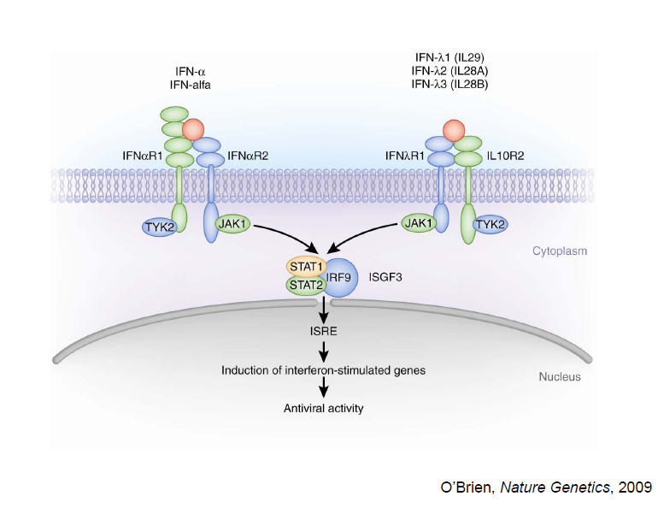

Slide 26
Compared with Peg-IFN alfa-2a, Peg-IFN lambda-1 "showed more rapid and a slightly more profound antiviral activity over the first weeks of therapy in genotype 1 and 4 [infected patients] and [in genotype] 2 and 3 infected patients.

Slide 27
The cEVR [complete early viral response] rates, negativity at week 12, for genotype 1 and 4 infected patients . . . showed significantly enhanced virologic responses, from roughly 38% for Peg-interferon alfa-2a to levels of 55% to 56% with the various doses of Peg-interferon lambda.“
Genotypes 1 and 4 are the most difficult to eradicate with antiviral therapy.

Slide 28
For genotypes 2 and 3, the cEVR at 12 weeks was very similar across all dosages of Peg-IFN lambda (83% to 90%), and was similar for Peg-IFN alfa-2a (86%).

Slide 29
Peg-IFN lambda had a better adverse-effect profile than Peg-IFN alfa-2a. "There was no dose-dependency of the side effects for the 3 doses of interferon lambda," .
"There were big differences, profound differences, in particular for the flu-like symptoms, which in some instances were 4 to 5 times higher with interferon alfa than with interferon lambda."

Slide 30
Flu-like symptoms occurred in 42.9% of patients receiving Peg-IFN alfa-2a but in only 9.7% to 12.5% of those receiving Peg-IFN lambda.
Musculoskeletal symptoms affected 46.6% of the Peg-IFN alfa-2a group but only 14.2% to 18.0% of the Peg-IFN lambda group.
longer therapy and observations will be required to see if there is a difference in the neuropsychiatric adverse effects, such as depression and irritability, that have been associated with the 2 forms of interferon

Slide 31
Fewer hematologic abnormalities occurred with Peg-IFN lambda, including anemia, neutropenia, and thrombocytopenia.
Anemia necessitated RIBAVIRIN dose reductions for 12.8% of the Peg-IFN alfa-2a group but in no more than 2.3% of the patients in any of the 3 Peg-IFN lambda groups.

Slide 32
However, treatment-emergent liver-related laboratory abnormalities occurred
more frequently with Peg-IFN lambda.
Treatment with Peg-interferon lambda had a higher rate of patients showing increased aminotransferase; this was particularly visible for patients receiving the 240 μg dose of interferon lambda. . . . but was not that prevalent in patients receiving only 120 or 180 μg

Slide 33
The incidence of elevations in serum bilirubin level was highest at the 2 higher doses of Peg-IFN lambda, and especially at the highest dose Considering the alanine transaminase and bilirubin elevations at the highest dose, "we suspect that they may go for one of the lower doses
(European Association for the Study of the Liver (EASL) 46th Annual Meeting. (Presented April 2, 2011س

Slide 34
Interferon Lambda Beats Interferon Alfa-2a . ,In addition, Peg-IFN lambda appeared to be better tolerated and safer.

Slide 35
THE ORAL VARIANT OF IFN-Α
The implantable device for continual long-term delivery of IFN-ω are examples of technologies developed to date for easier drug administration

Slide 36
TARIBAVIRIN
In terms of RBV, efforts have been extended to reduce the incidence of hematologic side effects through the identification of its less toxic analogues.
Taribavirin* is an RBV prodrug that is preferentially taken up by hepatocytes and, therefore, be less potent in inducing anemia.

Slide 37
TARIBAVIRIN
Although phase 3 clinical trials in which taribavirin was combined with PEG-IFN did not achieve the efficacy obtained with standard-of-care therapy, hematologic side effects were significantly decreased compared with PEG-IFN/RBV.[
However, because a uniform dose of taribavirin was used in the trial, weight-based dosing might improve the response rates achieved with this drug

Slide 38
TOLL-LIKE RECEPTOR(TLR)AGONISTS
Augmentation of host immune responses represents another strategy aimed at improving the efficacy of HCV treatment. One such approach was the development of Toll-like receptor (TLR) agonists.*

Slide 39
TOLL-LIKE RECEPTOR (TLR) AGONISTS
. TLRs are expressed on the surface of immune cells;
They recognize pathogen-associated molecular patterns and subsequently trigger innate and adaptive immune responses.

Slide 40
Toll-like receptor (TLR) agonists
Several TLR agonists have been developed and have shown some anti-HCV effects in early trials.^{[38]} Unfortunately, due to lack of efficacy and safety issues, further development of some of these compounds, including CPG 10101* and ANA975,* has been halted

Slide 41
VACCINES
Some efforts have also been focused on the development of vaccines that might help improve HCV-specific T-cell responses. IC41,* a vaccine that contains several HCV epitopes, and GI-5005,* a heat-inactivated recombinant yeast strain that produces an NS3-core fusion protein, are among the most promising HCV

Slide 42
VACCINES
Both of these agents were shown to be safe, well tolerated, and immunogenic.
Their efficacy in eradication of HCV when combined with the current standard-of-care therapy, however, is still under investigation

Slide 43
Conclusion
Despite these advances, major barriers to treatment still exist, including that many patients remain undiagnosed; the complexity, cost, and toxicity of current therapies; and the availability of qualified providers to treat hepatitis C.
Addressing these factors should be a priority to help change the natural history of this progressive disease and minimize the substantial healthcare burden associated with HCV infection.

Slide 44
DAAs
Finally, several DAAs that inhibit specific steps in the viral life cycle using small molecules, siRNAs (small interfering RNAs), and specific antibodies are currently in preclinical and clinical stages of development. Thus far, small molecules that directly inhibit the HCV NS3-NS4A protease and NS5B RNA polymerase have the greatest promise as novel HCV-specific agents. Protease inhibitors telaprevir* and boceprevir* and the polymerase inhibitor RG7128* (studied in combination with PEG-IFN/RBV) are furthest along in development in their respective classes, and they are presently in phase 3 and 2 clinical trials, respectively

Slide 45
DAAS
Achieved SVR rates superior to those observed with the current standard of care.
Added promise of decreased duration of therapy.[
Associated with more severe side effects, such as worsening anemia and, in some cases, rash, when added to PEG-IFN/RBV.
Despite the excellent efficacy and acceptable safety profiles that have been demonstrated thus far for some DAAs, a concern exists about the emergence of viral resistance

Slide 46
DAAS
Due to the high replication rate of HCV and the low fidelity of the HCV polymerase, use of DAAs as single agents can lead to the rapid development of drug-resistant mutations resulting in treatment failure, precluding such a treatment model. However, the use of agents with complementary mechanisms of action and non overlapping resistance profiles may eventually enable elimination of IFN as part of the standard treatment for HCV infection.

Slide 47
Viral resistance
is a new concern that has emerged with the DAAs. The HCV has a high rate of turnover, and the RNA polymerase has poor fidelity, resulting in a large number of viral variants, known as quasispecies.^{[37]} Some of these variants may be naturally resistant to DAAs. With boceprevir and telaprevir monotherapy, in vitro analyses have shown that resistant mutations in the NS3 protease region emerge or are selected soon after the start of therapy.^{[38]} In general, virologic breakthrough with emergence of resistance appears to be associated with lower trough serum levels of telaprevir and/or pegylated interferon,^{[28]} highlighting the importance of adherence with these often complex regimens.

Slide 48
The consequences of resistance remain unknown. In the case of telaprevir-resistant mutants, it appears they remain susceptible to interferon and ribavirin-based therapy.^{[37]} It is not known whether the selection of resistant variants will influence the rate of disease progression and whether patients who develop resistance after treatment with one protease inhibitor will also be resistant to other drugs in the same or different class. Preliminary data suggest that there is considerable overlap in resistance between telaprevir and boceprevir

Slide 49
Adherence to these triple therapy regimens may be challenging. For example, both telaprevir and boceprevir must be taken every 8 hours, with a "window of opportunity" of 7 to 9 hours between doses. In practice, it may be difficult for patients to adhere to such a strict protocol, particularly for the middle-of-the day dose that may be forgotten by patients during a busy work day

Slide 50
Protease Inhibitors
Telaprevir, an oral inhibitor of the NS3/4A serine protease,^{[26]} and boceprevir, another inhibitor of the HCV NS3 serine protease, are potent inhibitors of viral replication.^{[27]} Both of these compounds must be used in combination with the current standard of care (pegylated interferon and ribavirin) because of the risk for the development of resistance if used as monotherapy^{[28]} or only with pegylated interferon

Slide 51
Other Therapies on the Horizon
In addition to a number of other protease inhibitors currently in phase 1 and 2 clinical trials, another class of DAAs, the polymerase inhibitors (which inhibit the RNA-dependent RNA polymerase responsible for RNA synthesis), both nucleoside and nonnucleoside, are also in the development pipeline.

Slide 52
RG7128*
. is a potent nucleoside polymerase inhibitor that appears to have a high barrier to resistance and is well tolerated.
RG7128 also appears to be effective for the treatment of patients with HCV genotype 2 or 3 infection who have failed to respond to a previous course of pegylated interferon and ribavirin-based therapy.^{[40}

Slide 53
In addition, trials evaluating combination therapy with RG7128 and a protease inhibitor may pave the way to either ribavirin-free and/or interferon-free treatment regimens in the future

Slide 54
Debio-025
,* a cyclophilin inhibitor, interferes with viral replication and appears to have an additive effect when combined with pegylated interferon in treatment-naive patients.

Slide 56
Conclusion
As newer, more effective and complex regimens are introduced, adherence to therapy will be of vital importance to ensure success and minimize resistance..

Slide 57
Conclusion
As newer, more effective and complex regimens are introduced, adherence to therapy will be of paramount importance to ensure success and minimize resistance. Despite these advances, major barriers to treatment still exist, including that many patients remain undiagnosed; the complexity, cost, and toxicity of current therapies; and the availability of qualified providers to treat hepatitis C. Addressing these factors should be a priority to help change the natural history of this progressive disease and minimize the substantial healthcare burden associated with HCV infection.

